Slide 1
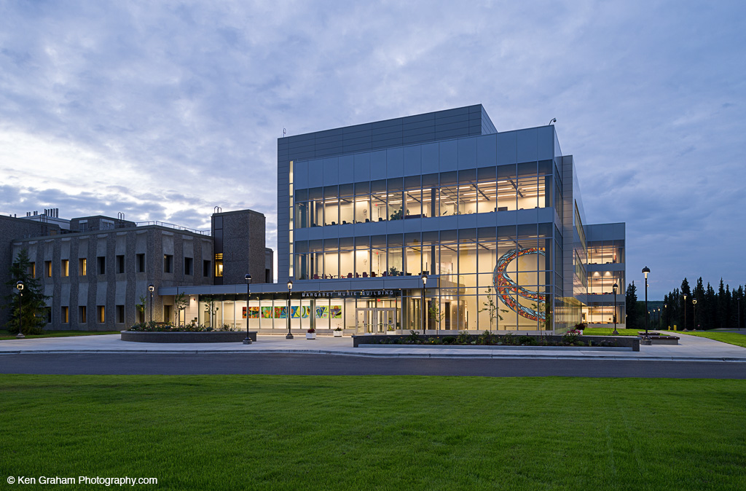
Campus Growth and CM/GC
University of Alaska Fairbanks
Inspiring discovery.
Inspiring greatness.
Inspiring, naturally.
Cameron Wohlford, PE
Mike Ruckhaus, PE
Sr. Project Manager

Slide 2
The Challenge
Science and Engineering Growth: Increased demand on facilities.
UAF saw increasing success in grant awards and student enrollment.
Growth placed strains on existing facilities and infrastructure.
Photos Courtesy of Todd Paris @ UAF Marketing and Communications

Slide 3
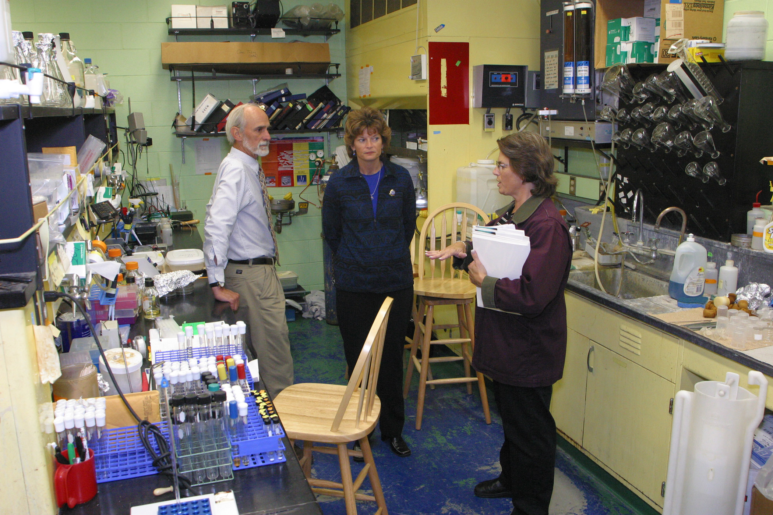
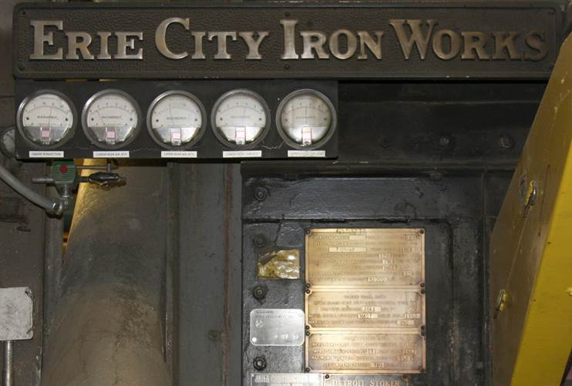
The Legacy Facilities:
Arctic-based Research and Teaching restricted by Legacy Facilities
UAF Heating and Power Infrastructure is undersized and out of date to match the demand.
Biology buildings were over 40 years old and new space had not been constructed since 1972.

Slide 4
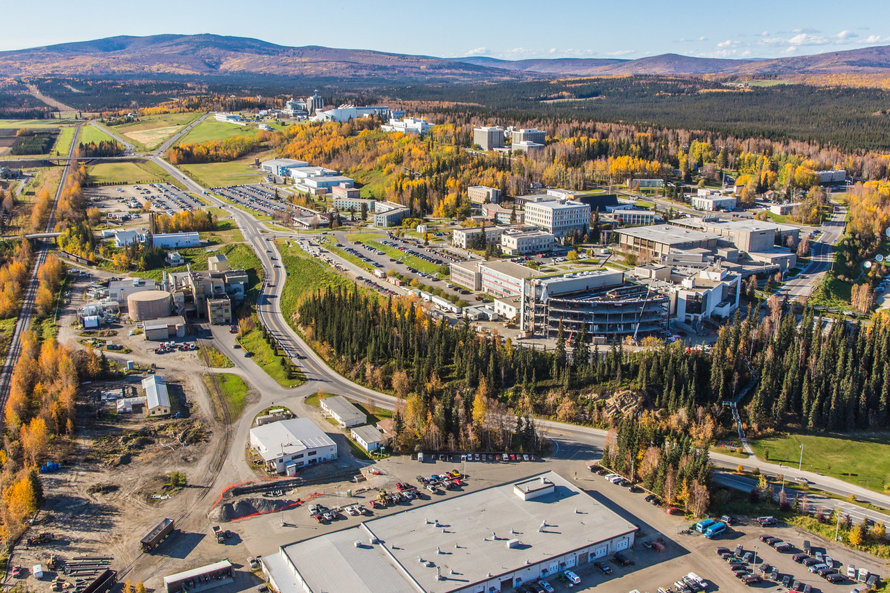
Expanding and Renewing the Campus
10-year capital plan Utilizing CM@Risk
Murie (Life Sciences)
AHRB Lab Renovations
Animal Care Facility
Critical Utilities
Arts Revitalization
Engineering
Combined Heat and Power
Photos Courtesy of Todd Paris @ UAF Marketing and Communications
Juneau-Lean Point Fisheries

Slide 5
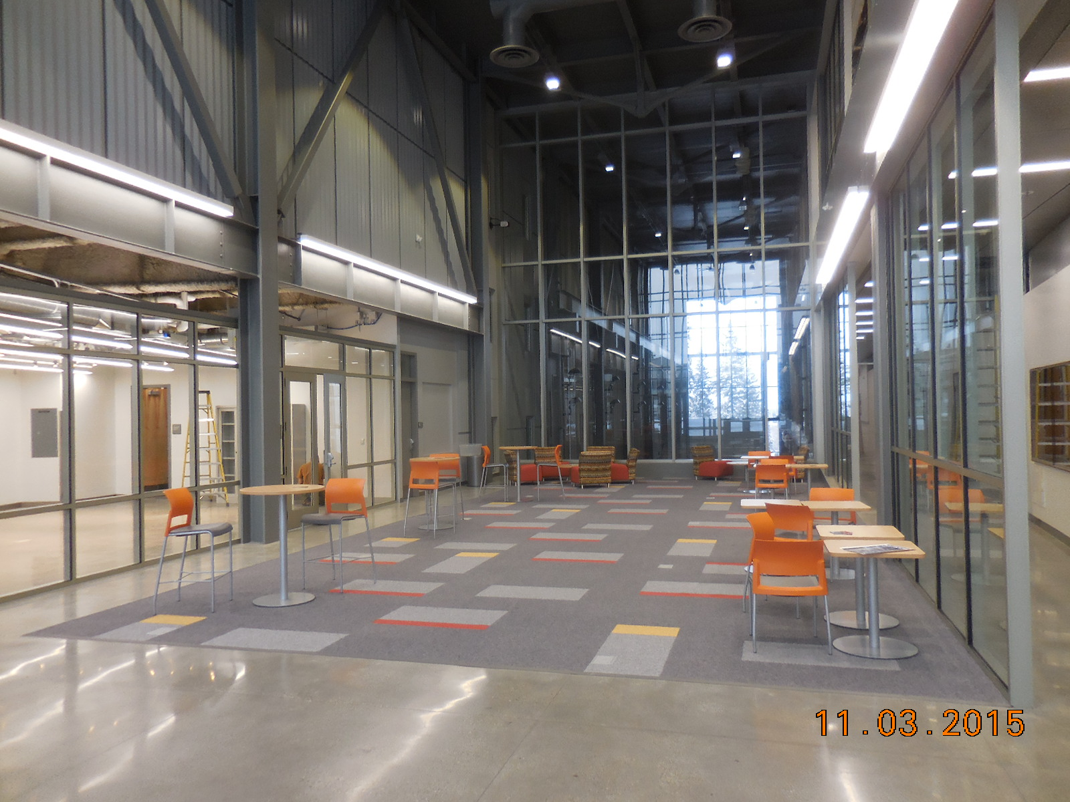
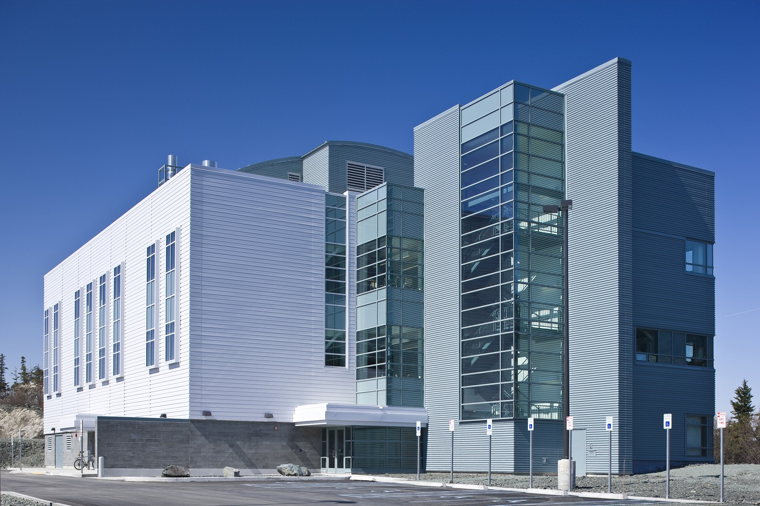
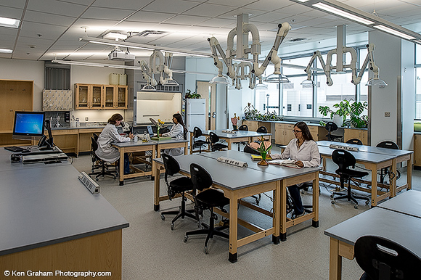
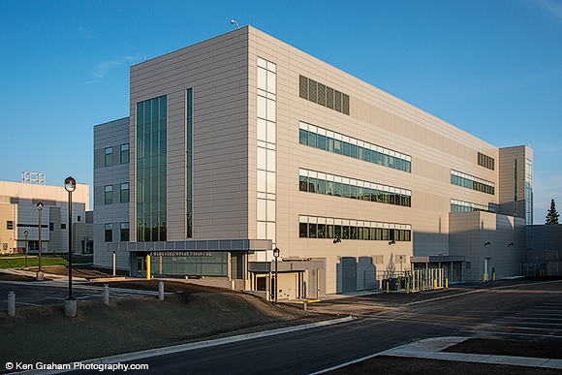
Progress through end of 2015
Over $500 million in total project cost
250,000 gsf of new and 30,000 revitalized STEM space
New 17MW Combined Heat and Power Plant
Power upgrade to 12470volt distribution and Converted 50+buildings.
Total Construction Cost: $375M
All Photos Courtesy of Todd Paris @ UAF Marketing and Communications
Ken Graham Photography, and Chris Arend Photography
Notes:
Note Efficiency 58% and Utilization rates

Slide 6
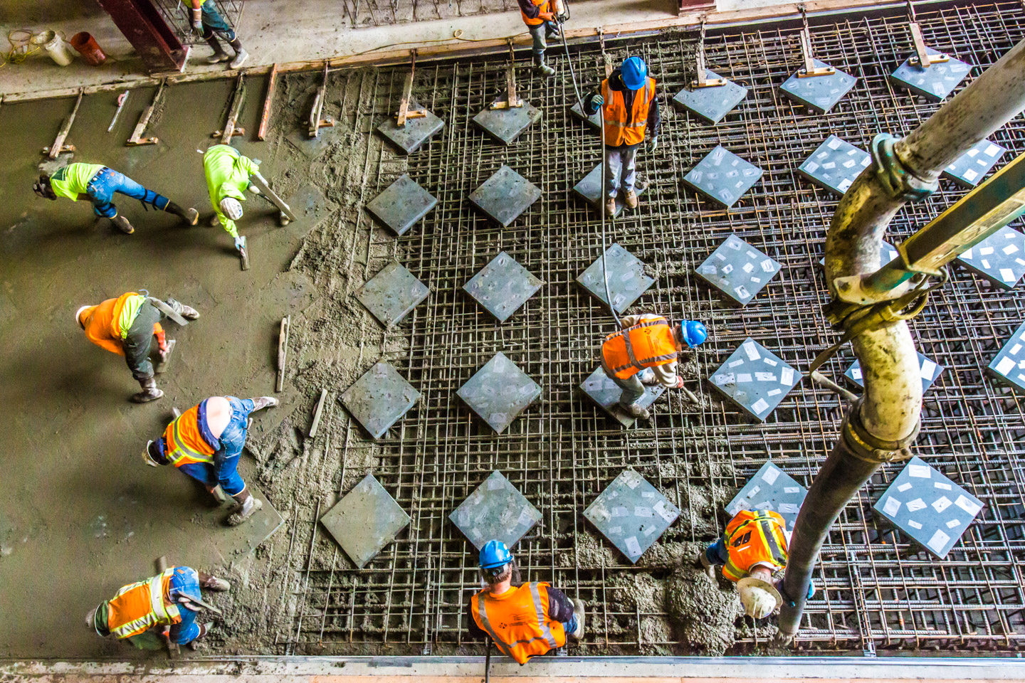
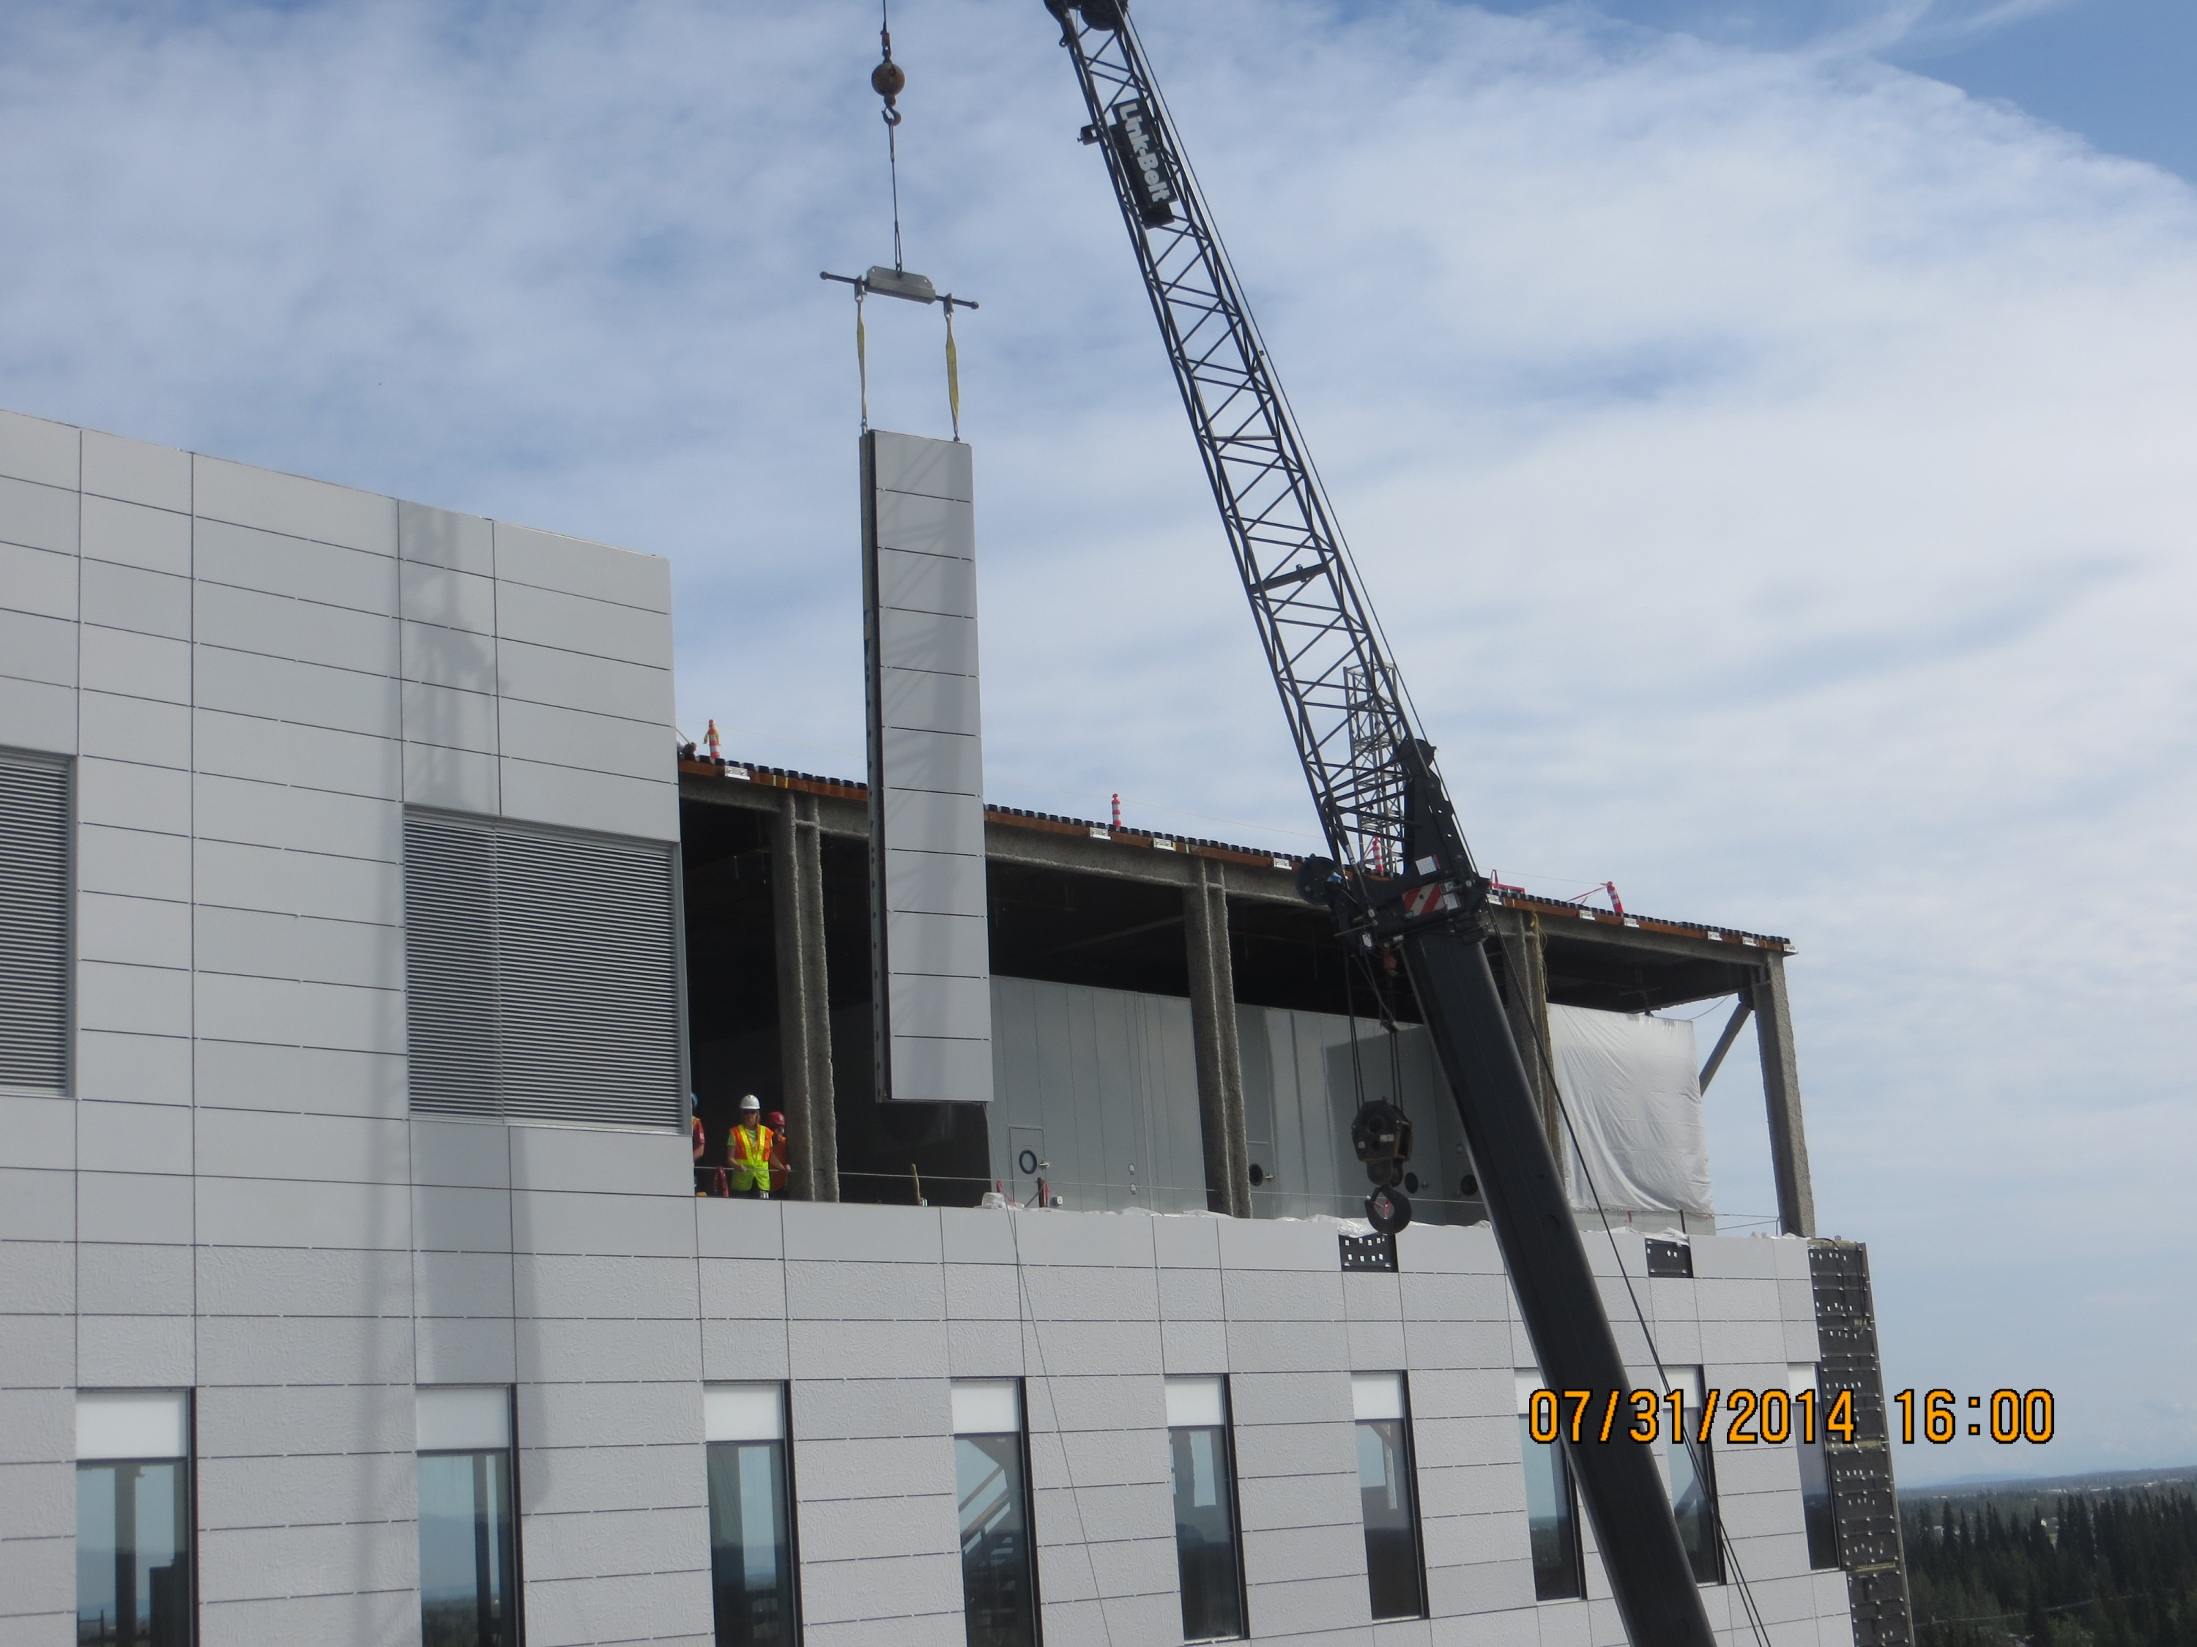
Capital Project Delivery
-UA has three typical delivery methods: low-bid, design-build, and innovative procurement
-Board Policy guides selection of the procurement method based on project risk and complexity
-UAF developed metrics for the delivery method selection
Photos Courtesy of Todd Paris @ UAF Marketing and Communications
Notes:
Discuss the 5-page guideline
-UA has three typical delivery methods: low-bid, design-build, and innovative procurement. Currently, Construction Manager at Risk is the allowable form of innovative procurement.
-Board Policy guides selection of the procurement method based on project risk and complexity and requires the University to ensure competition, price reasonableness, and the best value. Specific written approval is required to utilize innovative procurement
-UAF developed metrics for the delivery method selection

Slide 7
Project Delivery Method Selection
Complexity
Notes:
Describe the use of the chart.

Slide 8
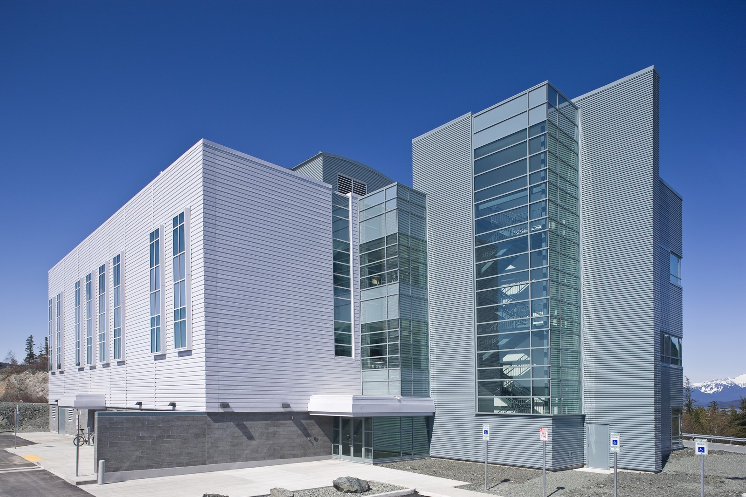
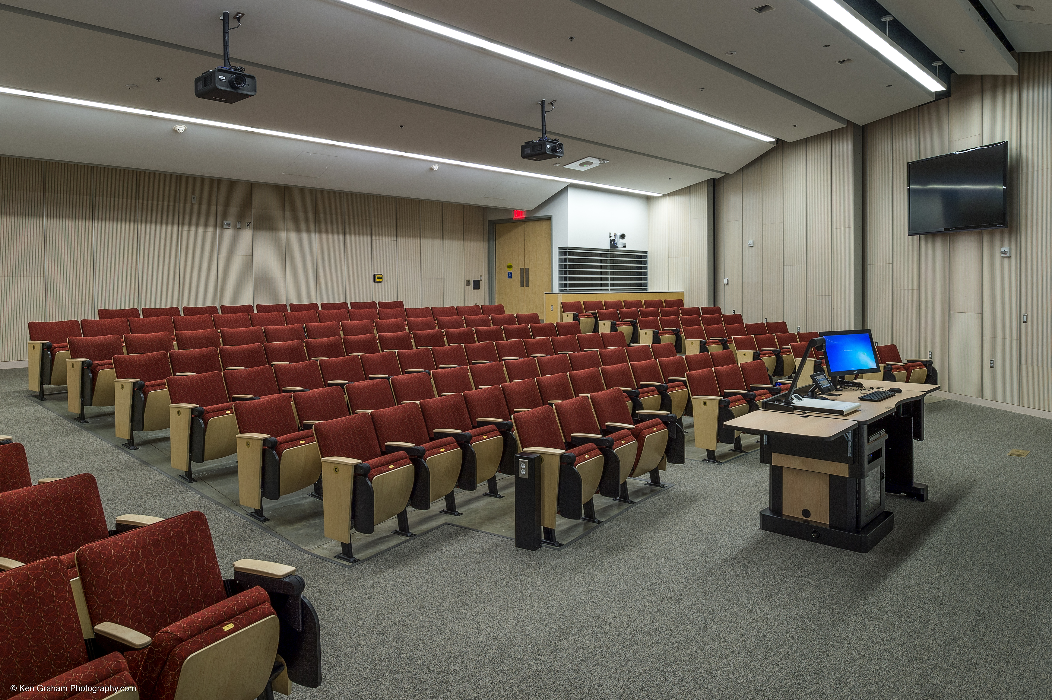
Use of CM@Risk at UA
-Typical for large projects or those with high degrees of risk and complexity
-Unique advantages to a University setting
-Early involvement and team building
-Early budget confirmation
-Fits with UA Fiscal Calendar
Notes:
Use of CM@Risk at UA
-Typical for large projects or those with high degrees of risk and complexity.
-Unique advantages to a University setting such as schedules and building access constrained by the academic calendar, protracted funding scenarios, and unique facility complexities such as 24-hour operations, research projects that cannot be upset, events that support the community and student body, etc
-Early involvement and team building ensures the CM@Risk has a vested interest in the University's success and continuation of mission.

Slide 9
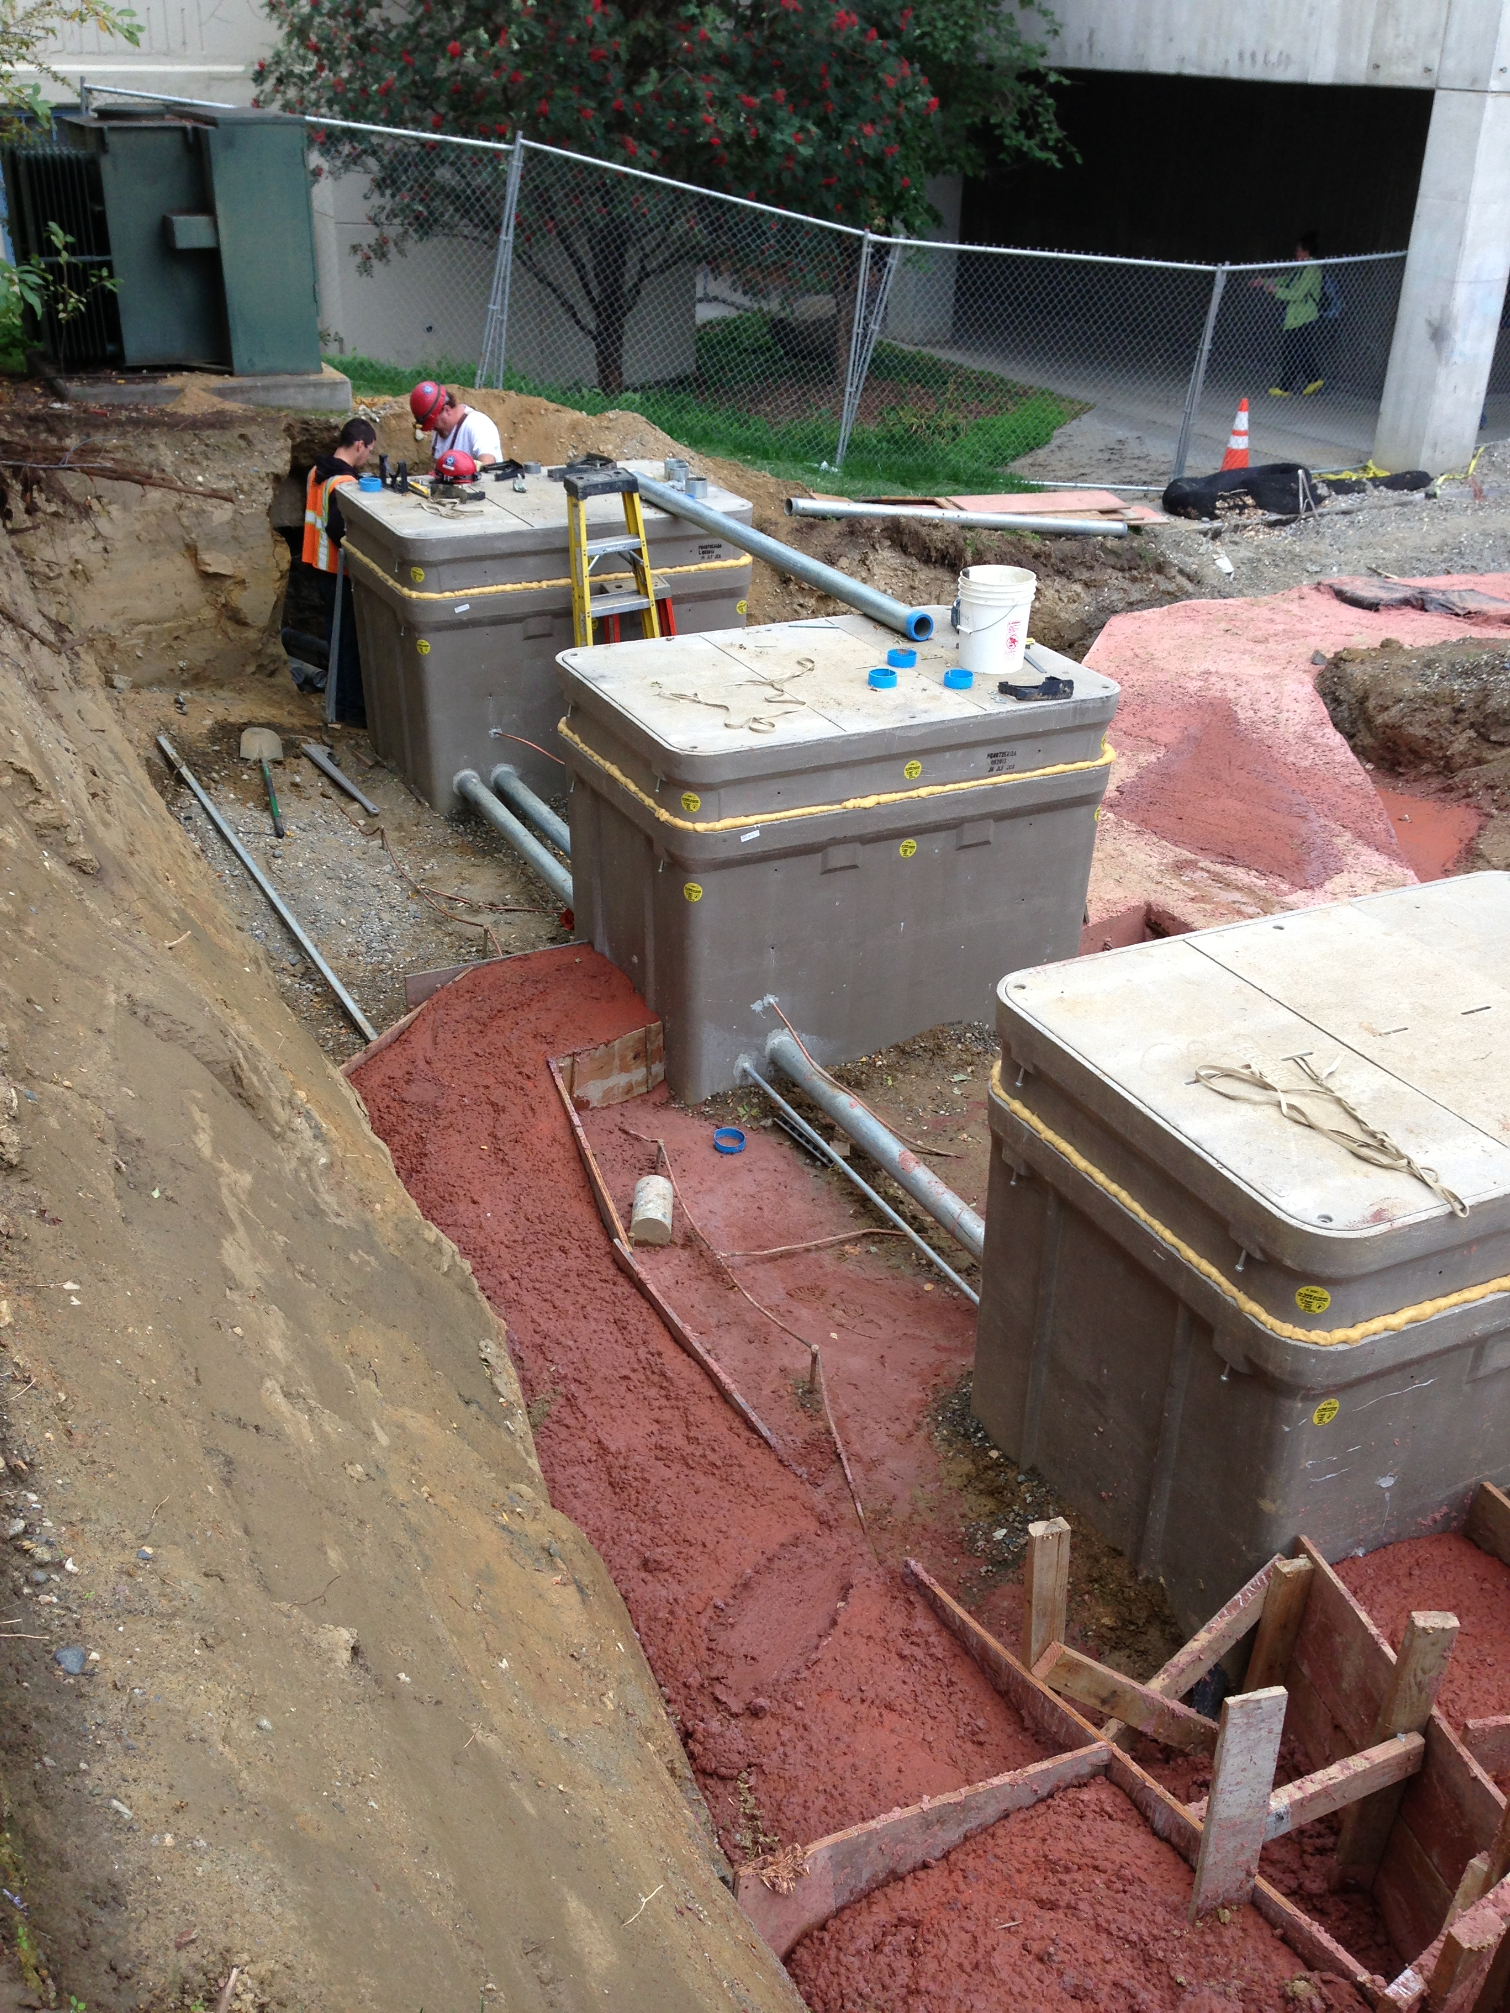
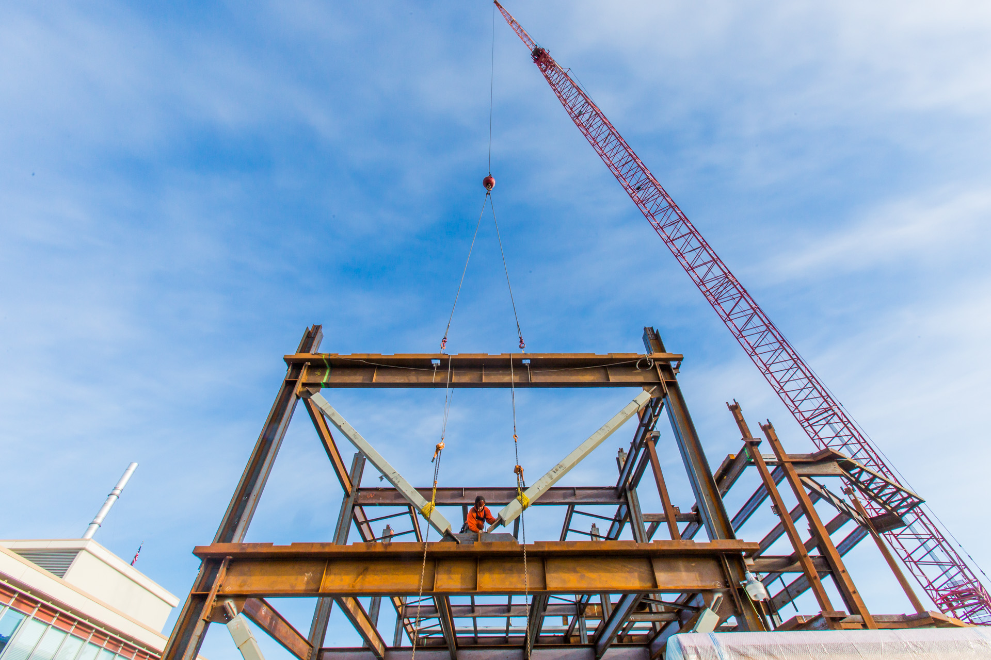
UA CM@Risk Selection
-Single-step RFP process with technical and price elements used to score and select.
-Committee of five review and score proposals
-Offeror with the highest combined score is selected for pre-construction.
-A construction contract may be issued if UA and the CM@Risk can come to terms on the GMP.
All Photos Courtesy of Todd Paris @ UAF Marketing and Communications
Notes:
-Single-step RFP process with Technical and Price elements used to score and select.
-Offeror with the highest combined technical (75%) and price (25%) score is selected for pre-construction.
-A construction contract is issued if UA and the CM@Risk can come to terms on the GMP.
-The GMP “cost-plus-fee” and contains limitations on what is corporate overhead versus direct job cost.
-The CM@Risk is required to select subcontractors either through an RFP process or lump-sum bid.
-Work is typically awarded in work packages, taking advantage of overlapping design and construction periods.

Slide 10
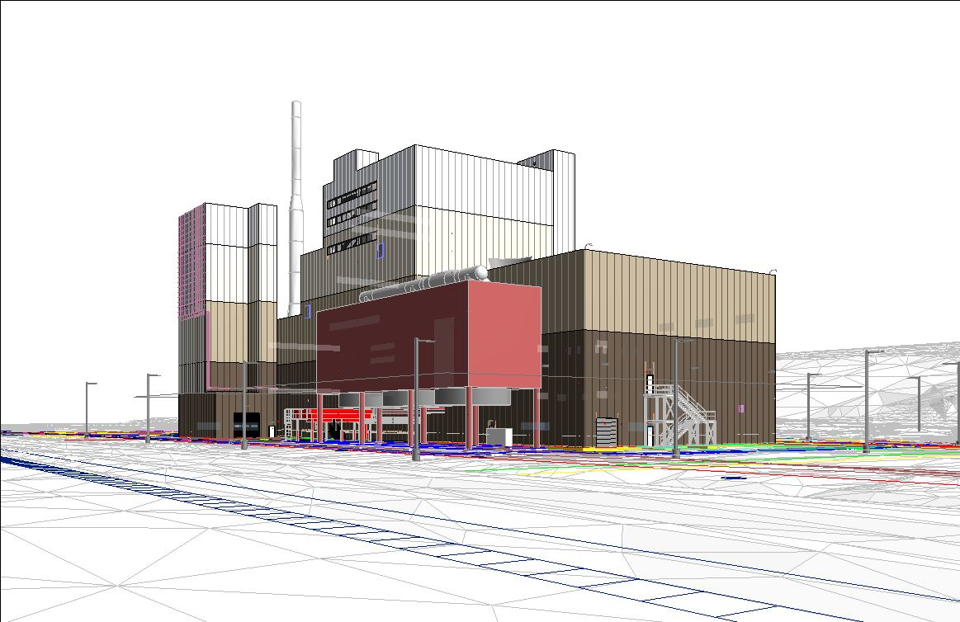
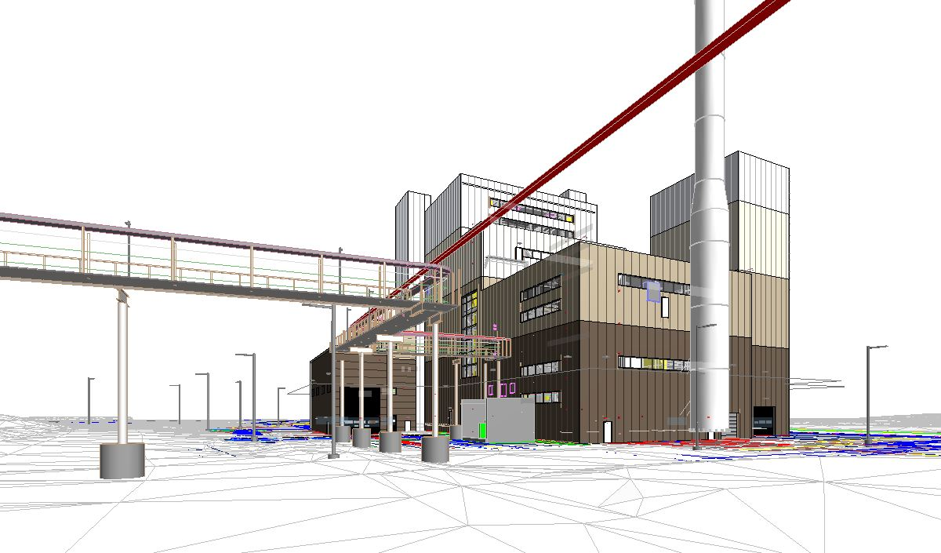
UA CM@Risk Services
-Pre-Construction Services
-Cost-plus-fixed-fee construction services
-UA reserves the right to award all or none of the work
-Work Packages and Long-lead Material Procurement
-Limits on self-performed work
-CM@Risk is required to select subcontractors through defined process
-Joint Contingency Management
-Real time budget forecasting

Slide 11
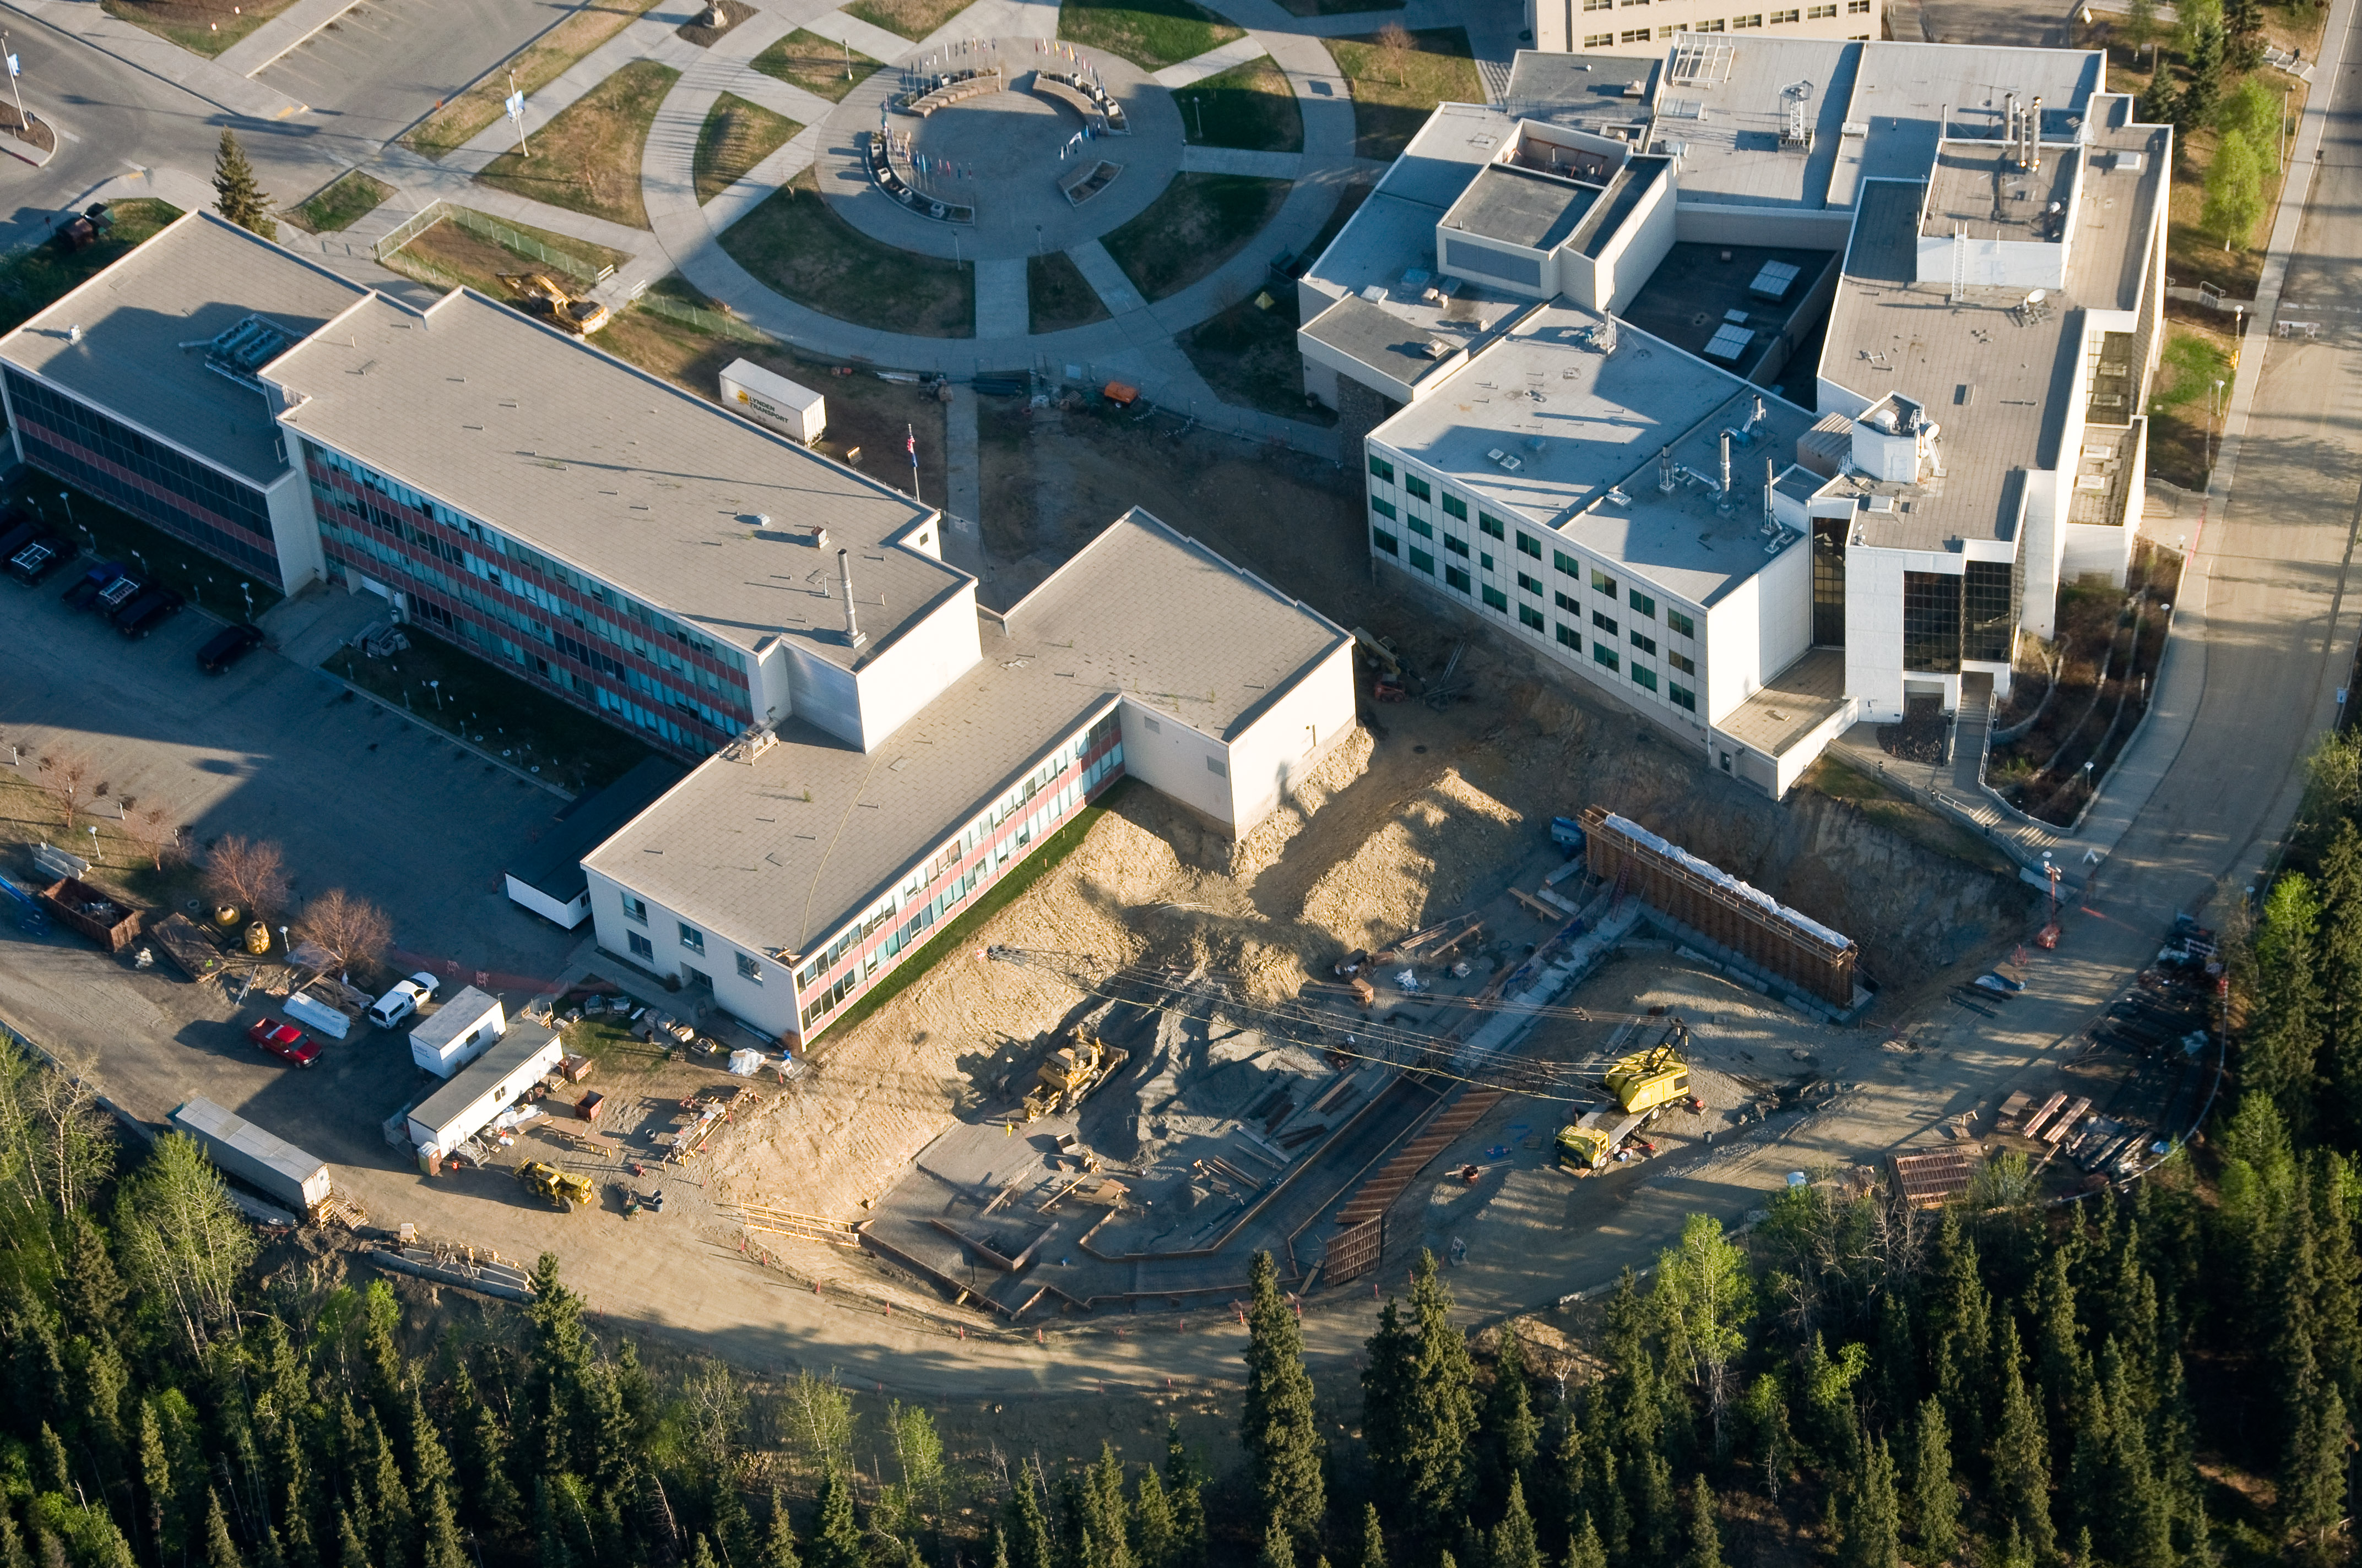
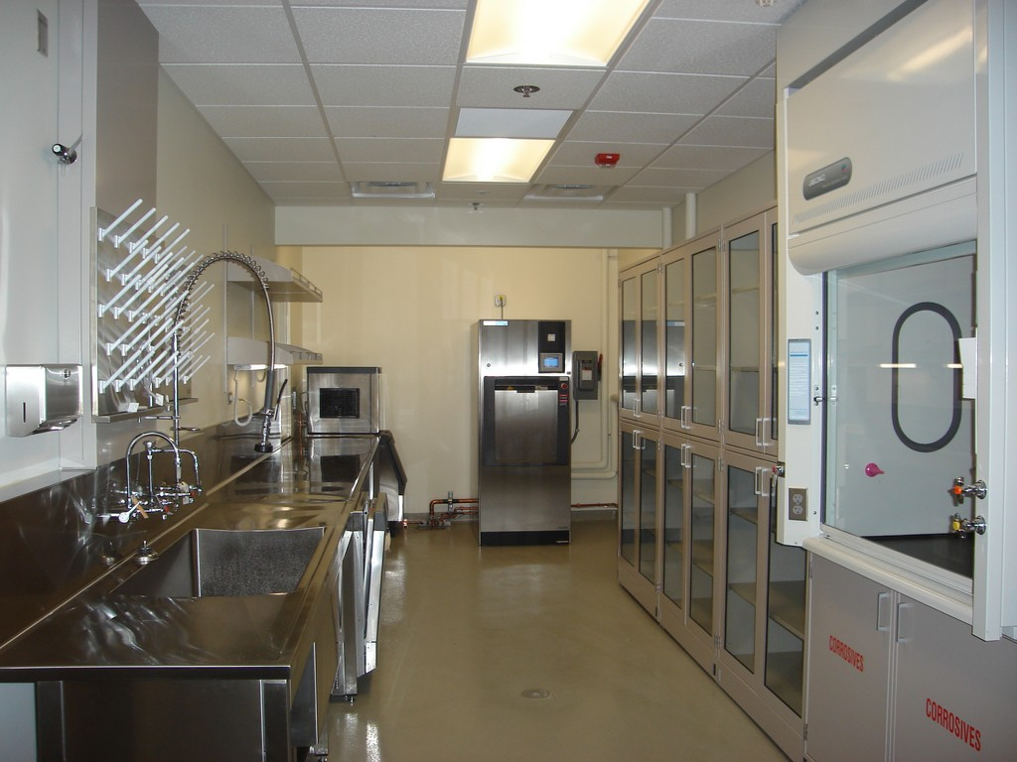
CM@Risk: Successes and Lessons Learned
Successes
-Managing the risk to academic and research programs
-Cost certainty and ability to maneuver contract dates around funding dates
-First reaction to an issue is solution based, not cost based
-CM@Risk takes full ownership of the QC program which is key for legacy buildings
-Constructability Reviews during design

Slide 12
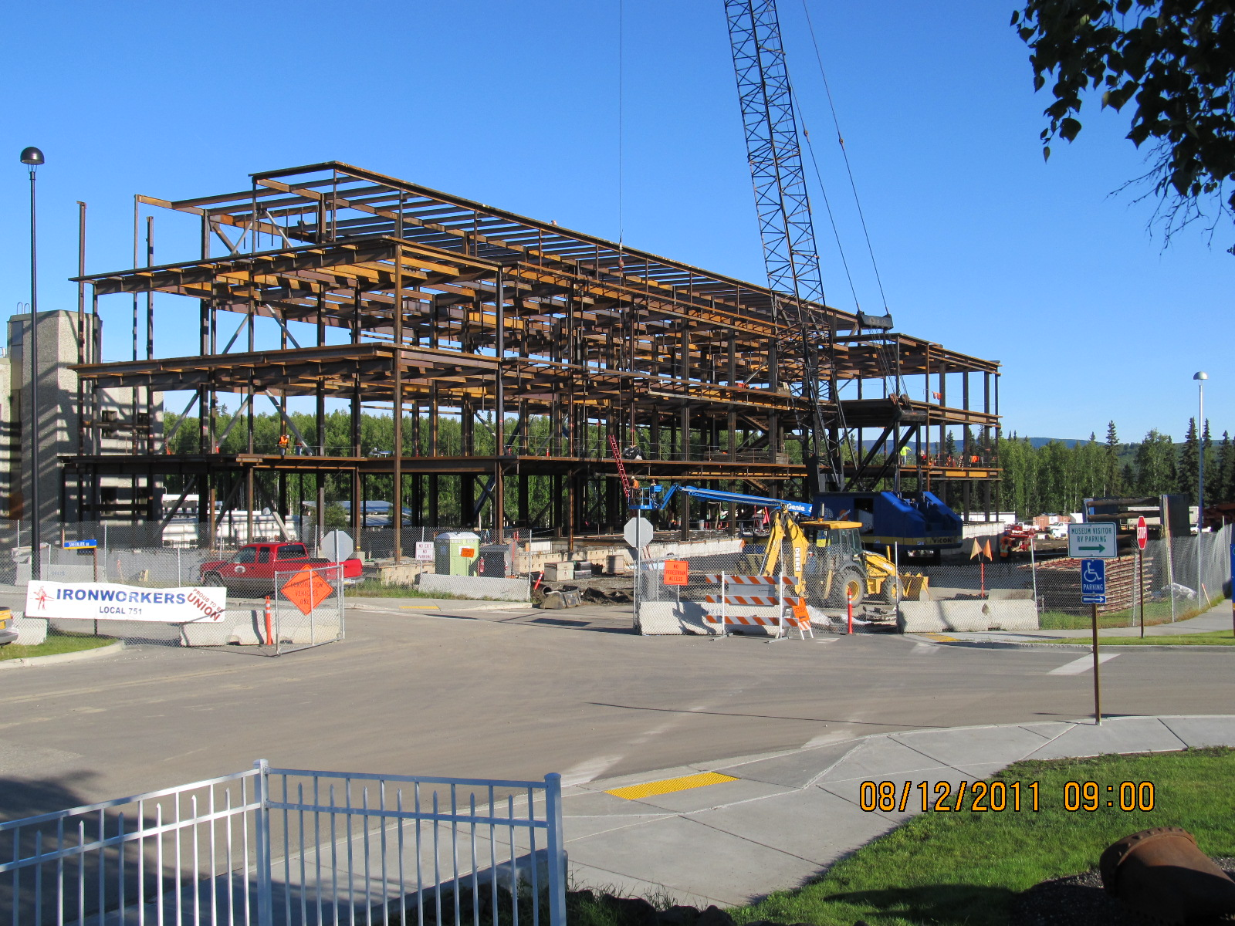
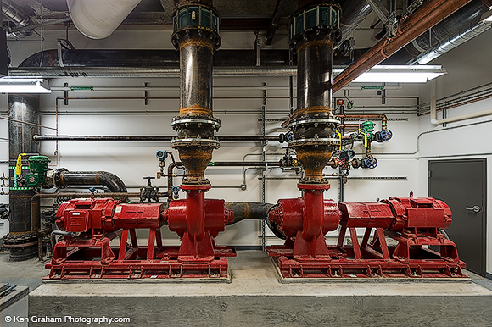
CM@Risk: Successes and Lessons Learned
-Transparent delivery method
-Adaptable to a stop-start funding plan
-Strategic Planning is easier and builds on the team dynamic between the CM@Risk, Designer, and Owner.
-Realized savings to the University
Notes:
-Transparent delivery method: quarterly financial reviews and audits of all contractor cost.
-Adaptable to a stop-start funding plan through work package awards.
-Strategic Planning is easier and builds on the team dynamic between the CM@Risk, Designer, and Owner.
-Ability to have direct input on General Conditions cost.
-Realized savings to the University: $3.0M

Slide 13
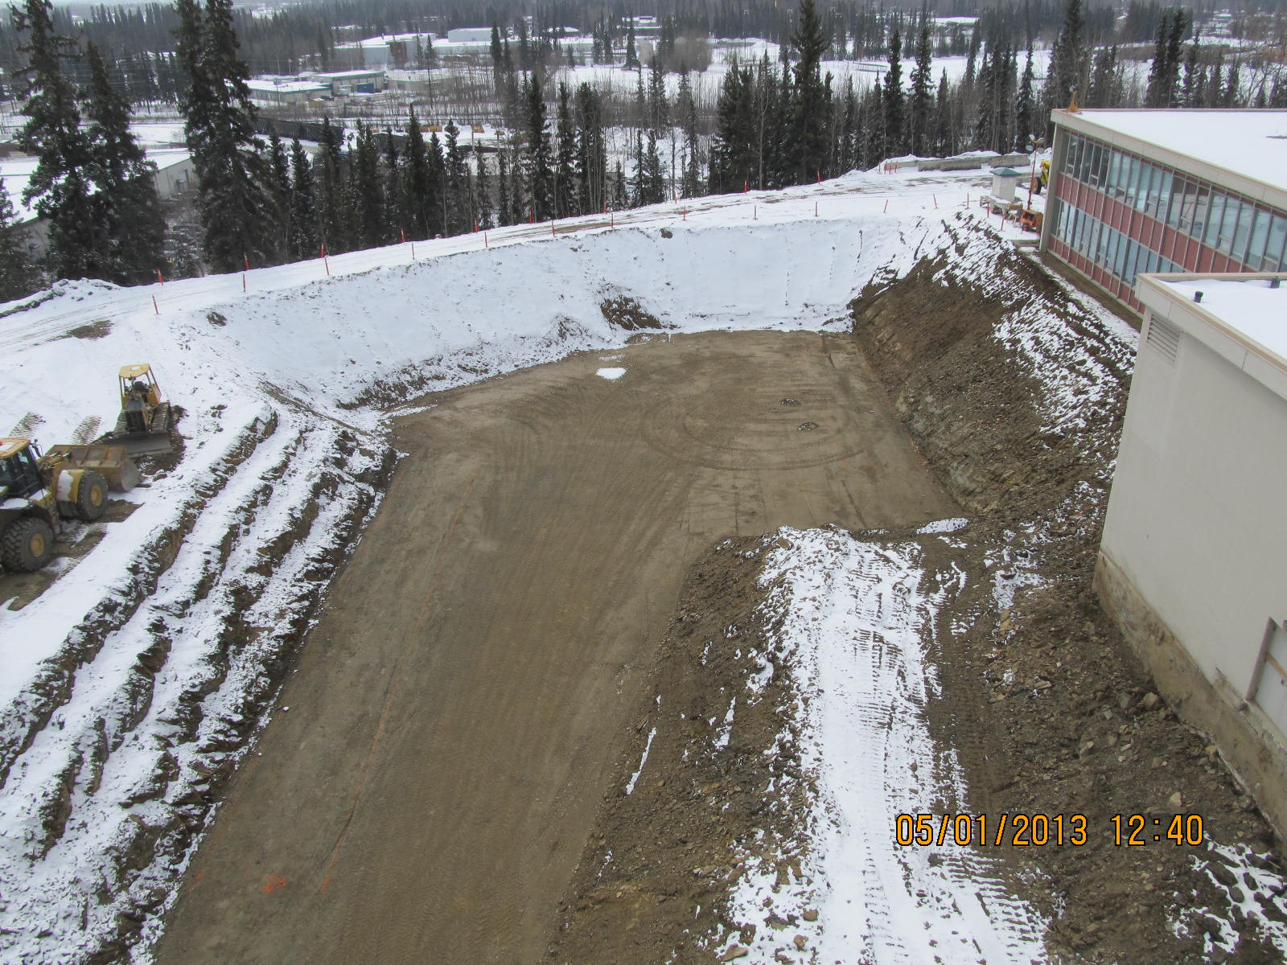
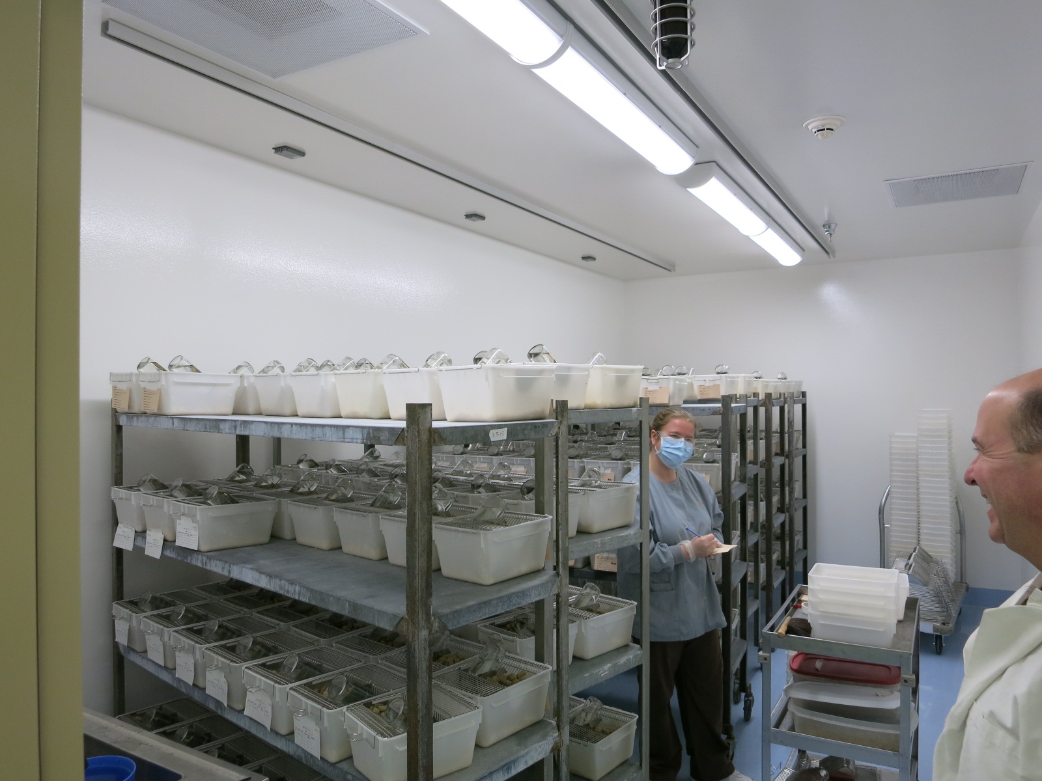
CM@Risk: Successes and Lessons Learned
Lessons Learned
-General Conditions cost can be tedious to manage
-Ownership of schedule float is shared in a CMAR
-Single-step Selection Process vs. Two-Step
-Management of Misconceptions
-Warranty Management
Notes:
Challenges
-General Conditions cost can be tedious to manage
-While the fee offered in the CM@Risk’s proposal may be much lower than market, their strategy is to make up the cost in self-performed work. Limits are needed on self-performed.
-Ownership of schedule float is shared in a CMAR; the Owner is absorbing some of the risk to allow the CMAR to be aggressive initially

Slide 14
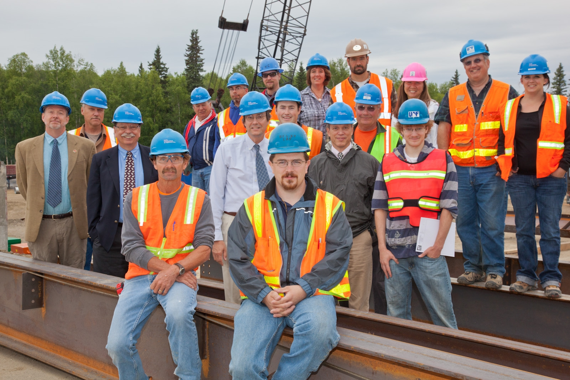
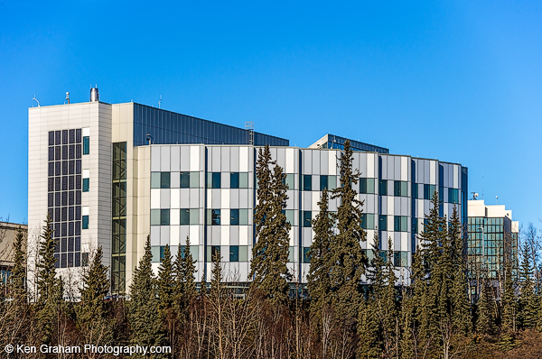
CM@Risk: Successes and Lessons Learned
-Shifting design ownership
-General Conditions Cost Management for CM@Risk and Pre-selected Subs
-Subcontractor selection must be competitive
-Flexibility to accelerate or decelerate construction based on funding

Slide 15
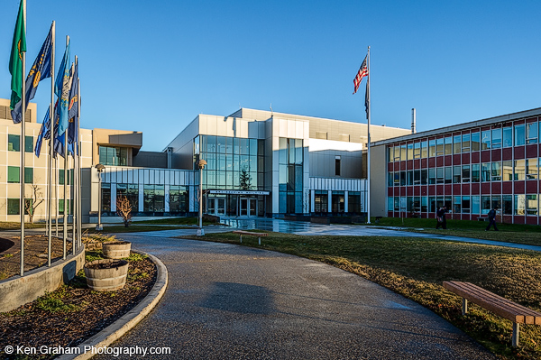
Why UAF utilizes CM@Risk
CM@Risk has excelled in all of the standard benchmarks
-No Claims
-No Court cases
-No budget overruns
-Building occupancy ahead of schedule
-High-quality construction with low maintenance and energy use
Realized savings reinvested into additional program and infrastructure
CM@Risk has taken a vested interest in the UA Mission and its success

Slide 16
cmwohlford@alaska.edu
moruckhaus@alaska.edu
www.uaf.edu
Notes:
Thank you! I think we have time for a few questions.
Answer Question
Thank you again and I will here for the remainder of the conference and look forward to speaking with you.

